Slide 1


Presentation Template (1)
June 03, 2017
CONTACT
Energy and Chemical Engineering
1st Engineering Building Room 201
Tel. +82 52 217 3542 Web. http://eche.unist.ac.krAddress

Slide 2
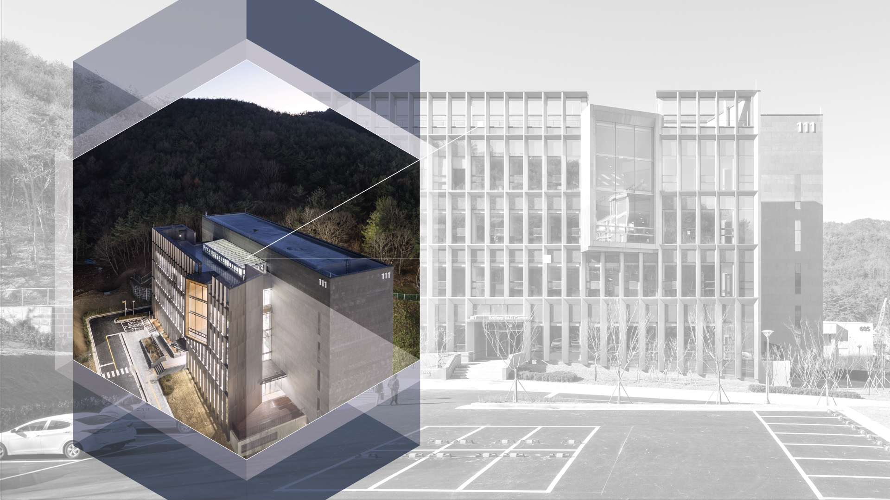

PPT Template Cover
Gil Dong Hong
UNIST PR team
Mar. 03, 2017

Slide 3

2
CONTENTS
1. Contents Title
03
4. Contents Title
21
- Contents Subtitle
- Contents Subtitle
2. Contents Title
08
5. Contents Title
27
- Contents Subtitle
- Contents Subtitle
3. Contents Title
13
6. Contents Title
35
- Contents Subtitle
- Contents Subtitle

Slide 4

3
Main title
In its short history, UNIST has grown to become a world-class university, with a rapidly growing reputation for its research and impact on a wide range of field. Leading scholars from all around the world have been invited to deliver outstanding scientific results and education. UNIST’s research facilities, along with its world class laboratory and state-of-the-art research equipment, have become an envy of many scientists around the world.
In order to serve and provide the nation with cutting edge technology and innovation, to promote local industry with technology and knowledge, and to lead and foster outstanding individuals for the country in science and technology, UNIST will promote the following three tasks.

Slide 5
4
Title
In its short history, UNIST has grown to become a world-class university, with a rapidly growing reputation for its research and impact on a wide range of field. Leading scholars from all around the world have been invited to deliver outstanding scientific results and education. UNIST’s research facilities, along with its world class laboratory and state-of-the-art research equipment, have become an envy of many scientists around the world.
In order to serve and provide the nation with cutting edge technology and innovation, to promote local industry with technology and knowledge, and to lead and foster outstanding individuals for the country in science and technology, UNIST will promote the following three tasks.
“ UNIST is reborn as a national research institute for science and
technology under a special law with government funding. ”

Slide 6
Title
5
sub-title
UNIST
UNIST
UNIST
UNIST
UNIST
Text two
Text two
Text two
Text two
Text two
Text two
Text two
Text two
Text one
Text one
Text one
Text one
Text one
Text one
Text one
Text one
Text three
Text three
Text three
Text three
Text three
Text three
Text three
Text three
Text four
Text four
Text four
Text four
Text four
Text four
Text four
Text four
Text five
Text five
Text five
Text five
Text five
Text five
Text five
Text five

Slide 7
Title
5
sub-title
01
02
03
04
UNIST will promote excellence in science and technology by improving our quality of research.
UNIST will promote excellence in science and technology by improving our quality of research.
UNIST will promote excellence in science and technology by improving our quality of research.
UNIST will promote excellence in science and technology by improving our quality of research.
“ UNIST is reborn as a national research institute for science and
technology under a special law with government funding. ”

Slide 8
Title
6
sub-title
China
USA
India
Egypt
Brazil
Australia

Slide 9




Title
7
sub-title
Sang Il Seok
Faculty
Sang Il Seok
Distinguished Professor
T. +82 52 217 2946
E. seoksi@unist.ac.kr
Distinguished Professor
T. +82 52 217 2946
E. seoksi@unist.ac.kr
School of Energy
And Chemical Engineering
Sang Il Seok
Sang Il Seok
Distinguished Professor
T. +82 52 217 2946
E. seoksi@unist.ac.kr
Distinguished Professor
T. +82 52 217 2946
E. seoksi@unist.ac.kr

Slide 10
THANK YOU

